Slide 1
Entity – Relationship Model

Slide 2
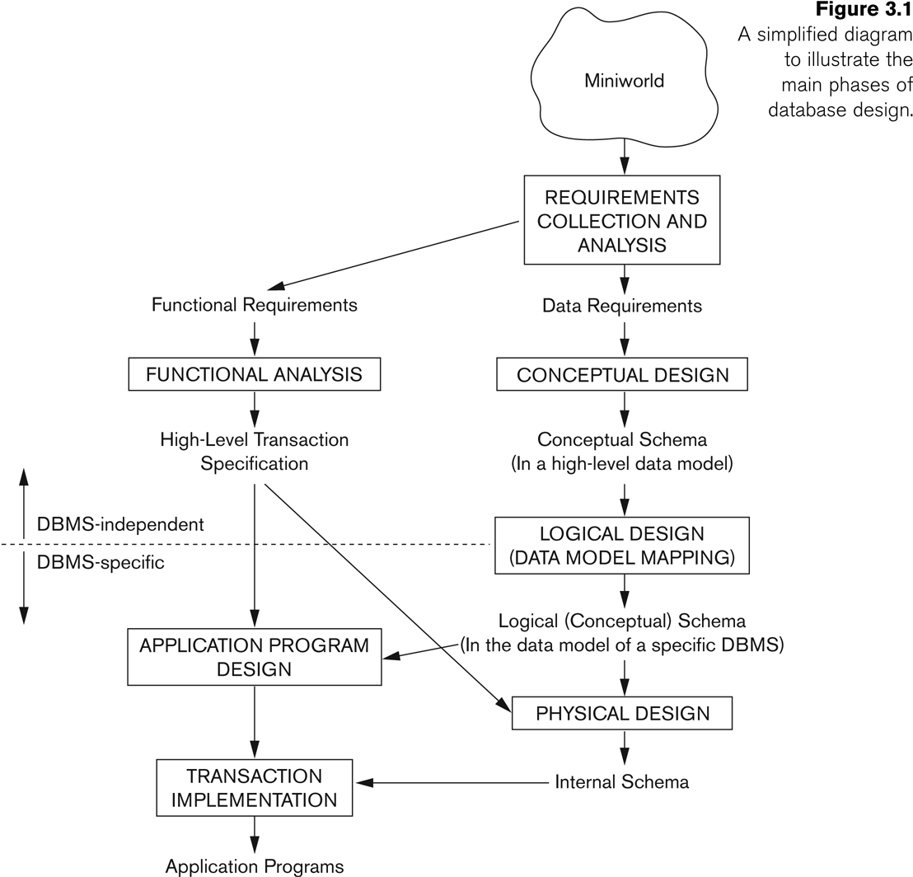
Overview of Database Design Process
Slide 3- 2

Slide 3
What is an ER Model ?
It is a conceptual model/tool with which you conceive the broad structure of the DB. You identify the components of the system, and their relationship between them. Identify various constraints that the system should satisfy.
Proposed by Peter P Chen in the 1976
It is a pictorial description of the database.
Simple enough for clients, yet Rigorous enough for system building.

Slide 4
How does an ER model Look:
Title
Author
Address
Membr Id
Publisher
Name
Borrowed By
Book
Lib Members
ISBN
Date of Issue

Slide 5
Entity
ENTITY → Attributes → Relationships → Cardinality → Special Cases

Slide 6
What is an Entity ?
Definition: Thing or Object in real world with independent existence
Should have either Physical or Conceptual Existence
Tangible objects
Virtual or Logical
A Set of distinguishable items/objects

Slide 7
Physical Entities | Conceptual/Logical Entities
Student | Course
Teacher/Faculty | Department
Book | Subject
Vehicle | Payment
Product | Order
Building | Reservation
Machine | Project
Laboratory | Feedback
Office | Policy
Employee | Role
Computer | License
Equipment | Subscription
Patient | Appointment
Customer | Invoice
Animal | Membership
Factory | Work Shift
Library | Fine
Warehouse | Inventory
Room | Event
Store | Transaction
Examples of Entities

Slide 8
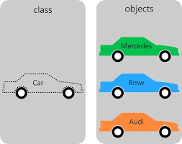
Entity vs Entity Set

Slide 9
Attributes
ENTITY → Attributes → Relationships → Cardinality → Special Cases

Slide 10
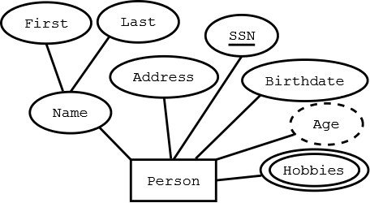
Attributes

Slide 11
What is an Attribute ?
These are Features/Properties which helps to characterize or distinguish an Entity
It is a piece of Information which distinguishes each row in a table.
In simple words, Attributes are the name of the Columns

Slide 12
Domain of an Attribute
The set of possible values an attribute of an Entity can take.
Phone_Num – Any 10 Digit number.
Name – String of max length 250
Email – String matching the format: <username>@<domain>.<extension>
Gender – Enum: {‘Male’, ‘Female’, ‘Other’}
Date_of_Birth – Date in the format YYYY-MM-DD
Salary – Decimal value with up to 2 decimal places, greater than 0.

Slide 13
Types of Attributes
Simple Attributes – Atomic, Indivisible
Composite Attributes – Has Multiple components
Derived Attributes - Depends on other attributes
Multi Valued Attributes
Complex Attributes – Composite + Multivalued.

Slide 14
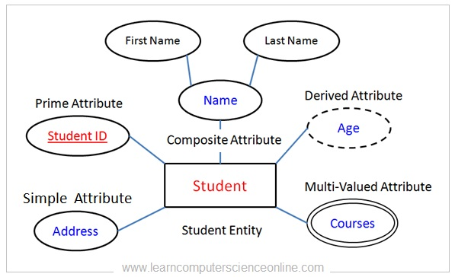
Types of Attributes

Slide 15
PRIME Attributes (KEYS in DBMS)
These are special attributes which helps to uniquely identify a row in a table.
Examples:
Aadhar Card,
Roll Num,
ISBN
What about (Aadhar + Roll Num) ? ➔ SuperKey
Prime Attributes need not be always a single attribute.

Slide 16
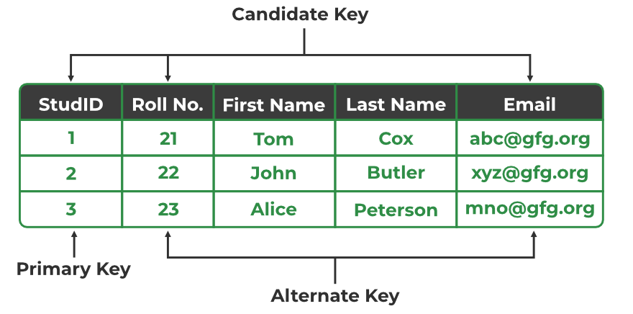
PRIME Attributes
Candidate Key
Super Key
Primary Key

Slide 17
Super key vs Candidate Key
Superkey: A set of one or more attributes that can uniquely identify a row in a table.
Candidate Key: A minimal superkey, (it has no redundant attributes)
EXAMPLE:
Students(Roll_no, Name, Email)
Superkeys: {Roll_no},
{Email}
{Roll_no, Name},
{Roll_no, Email},
{Email, Name},
{Roll_no, Name, Email}
Candidatekeys: {Roll_no},
{Email},

Slide 18
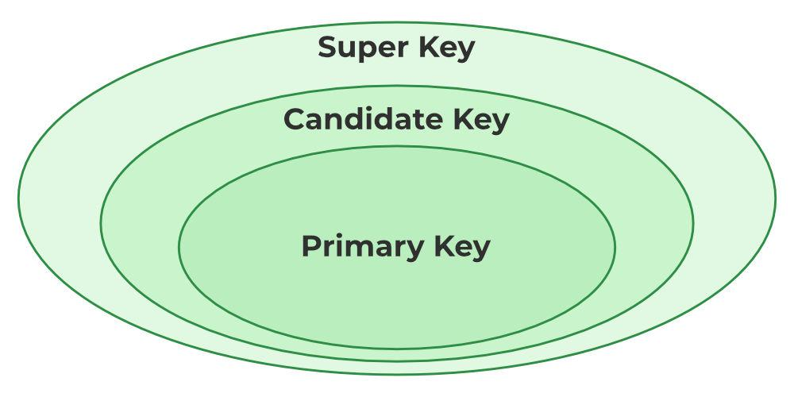
Keys In DBMS

Slide 19
Relationships
ENTITY → Attributes → Relationships → Cardinality → Special Cases

Slide 20
What is a Relationship ?
It is an association / Mapping between the entities
Entities by themselves requires information to be stored on their behalf.
Additionally oftentimes, there is also a need to maintain information about
the associations between them.
Borrowed By
Book
Lib Members
Borrowed by, is a relationship between the participating entities Book and Members

Slide 21
What is a Relationship ?
Borrowed By
Book
Lib Members
Formally,
Borrowed by
∩
Book X Members
The relationship Borrowed_By is a subset of the cartesian product between
the entities Book and Members

Slide 22
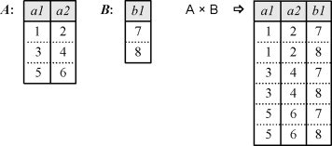
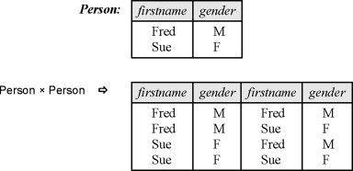
What is a Cartesian Product:

Slide 23
Relationship vs Relationship Type / Set
Same as earlier

Slide 24
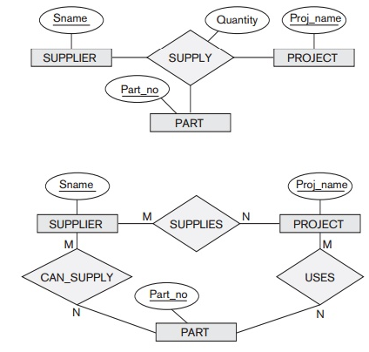
Degree of a Relationship
Ternary Relationship
Are they Equivalent
Binary Relationships

Slide 25
Degree of a Relationship
Ternary Relationship:
A supplier provides a specific part for a specific project.
Example: Supplier "A" provides "Bolt" for Project "X".
Three Binary Relationships:
  Supplier "A" is supplies to Project "X".
  Supplier "A" supplies "Bolt".
  Project "X" uses "Bolt".
  Problem: No way to specify that "A" supplies "Bolt" only for "X".
Conclusion: Ternary relationships capture the exact context, which is lost with three binary relationships.

Slide 26
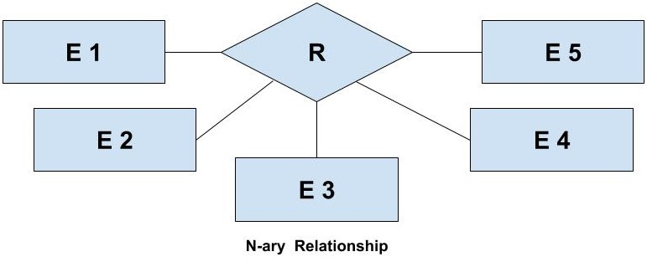
Degrees of Relationship

Slide 27
Cardinality Ratio
ENTITY → Attributes → Relationships → Cardinality → Special Cases

Slide 28
Cardinality Ratio
Often used to describe “Constraints” on a Binary Relationship
Consider borrowed_by relationship:
A book can be borrowed only by one person at a time.
But one person can borrow multiple books at a time.
C.Ratio helps to capture such kind of constraints

Slide 29
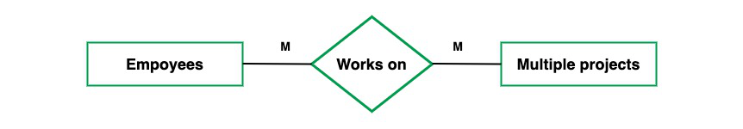
Cardinality Ratio
M
N
Projects
The maximum number of entities (Rows) from E1 that can be possible associated to E2
through R
Dictated by the usecase or the Policy of the organization

Slide 30
Cardinality Ratio
One to One
One to Many
Many to One
Many to Many

Slide 31
Participation Constraints
Participation constraint in an Entity-Relationship (ER) model defines the extent to which entities in an entity set are required to participate in a relationship set.
Participation Constraint == Minimum Cardinality Constraint

Slide 32
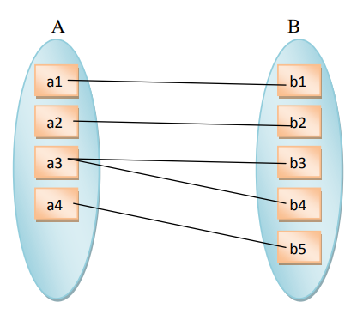
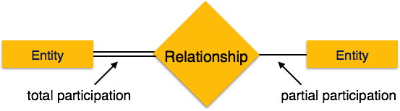
Participation Constraints
Total Participation
Entity A is participating totally on this Relationship.
It means that, all rows of A should appear / take part in the relationship.

Slide 33
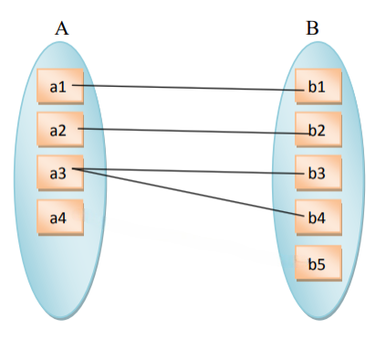
Participation Constraints
Partial Participation

Slide 34
Structural Constraints:
Cardinality Ratio + Participation Constraints = Structural Constraints
It reflects / captures the policy of the Organization, and
Needs to be enforced by the DBMS Software

Slide 35
Min – Max Notation
Cardinality Ratio - Bothers only about Maximum
Participation Constraints – Bothers only about Minimum
Go for Min – Max Notation
Very Precise & Explicit
Exact numbers can be used.

Slide 36
Min – Max Notation
M : N
Min Time
Max Time
0 → Partial Participation
>1 → Total Participation

Slide 37
Min – Max Notation
Belongs To
N
1
Professor
Department
Belongs To
Professor
1, 1
0, N
Department

Slide 38
Attributes of Relationships
Title
Author
Address
Membr Id
ISBN
Name
Borrowed By
Book
Lib Members
Where Should I put DOI ?
Date of Issue

Slide 39
Attributes of Relationships
The cardinality Ratio gives a guideline to shift the Attributes of relationships
Why should I shift it at the first place ?
Simplicity / Clarity
Efficient query Retrieval
Alignment with real world Semantics
Job Title
Works in
Employee
Department

Slide 40
Attributes Shifting - Guidelines
If it is a 1 to Many Relationship - Shift to the Many side.
If it is a 1 to 1 Relationship - Shift to any side. (Total Participating side preferred)
If it is Many to Many Relationship - Cant be shifted. Create separate table with IDS of both entities and attribute
Grade
Enrolled In
M
N
Student
Course

Slide 41
Special Cases
ENTITY → Attributes → Relationships → Cardinality → Special Cases

Slide 42
Recursive Relationships
Manages
Reports to
Staff
Worker
Pre-Requisites
Pre Req
Course
Course

Slide 43
Weak Entity
An entity set whose members “Owe” their existence to some other Entity.
Strong / Owner Entity
They cannot exist Independently. (Not enough attributes to distinguish them Uniquely)
No key, Only Partial Key
They are Existential Dependent – To exist they must depend on some other entity

Slide 44
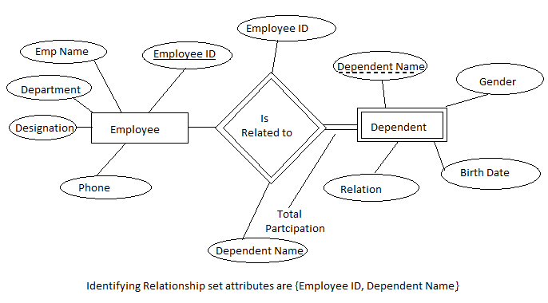
Weak Entity - Examples

Slide 45
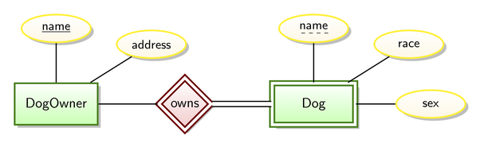
Weak Entity - Terminologies
Known as Partial Key or Discriminator
1
N
Called as Identifying Relationship
Double walled Rhombus
They are generally Many to One relationships

Slide 46
Weak Entity – As Composite Multi Valued Attribute
Name
Dog
Age
Dog
Sex
Dog Owner
This can be done, when you are sure that the ‘Dog’ entity is not going to take part in a relationship with
any other entity. In that case it is simple enough to be modelled as an attribute.
If a thing, even though not of independent existence, but participates on other relationships on its own
➔ Best captured as a weak entity

Slide 47
Some Nuances

Slide 48
Example
Title
Author
Address
Membr Id
Publisher
Name
Borrowed By
Book
Lib Members
ISBN
Date of Issue

Slide 49
Example
Title
Author
ISBN
Member_Name
Book_User
Member_Address
Membr Id
Date of Issue
Lots of Duplication
Inefficient
Missing Values for Some Attributes
CRITERIA: For a given entity all of its attribute values should be defined

Slide 50
Example
Emp_Code
Phone_Num
Phone_Type
Has a
Staff
Phone
Emp_Code
Phone_Num
Phone_Type
Staff
Good Approach: If all staff has a phone, and all phone is associated with a staff.
Bad Approach: Say if an office phone is general & No staff is
associated to it ➔ Go for Relationships

Slide 51
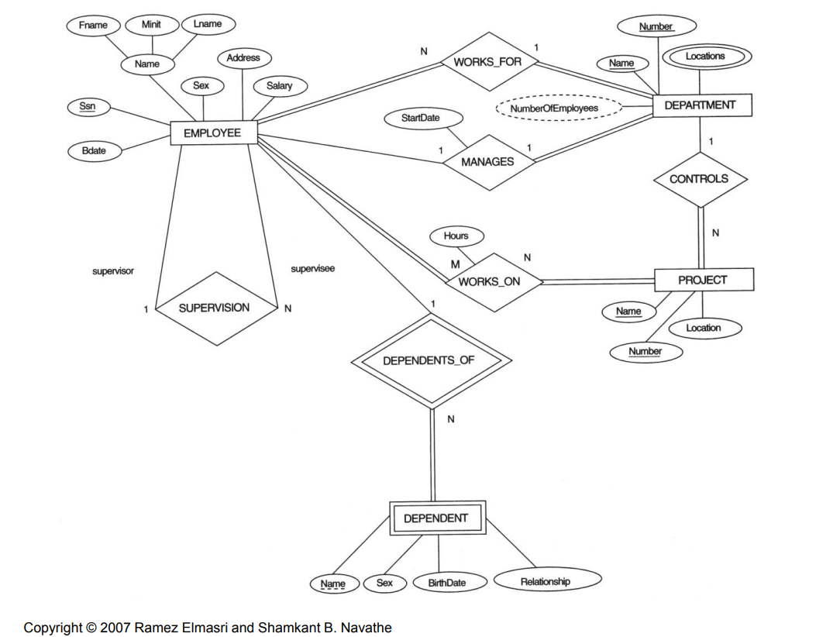
From This

Slide 52
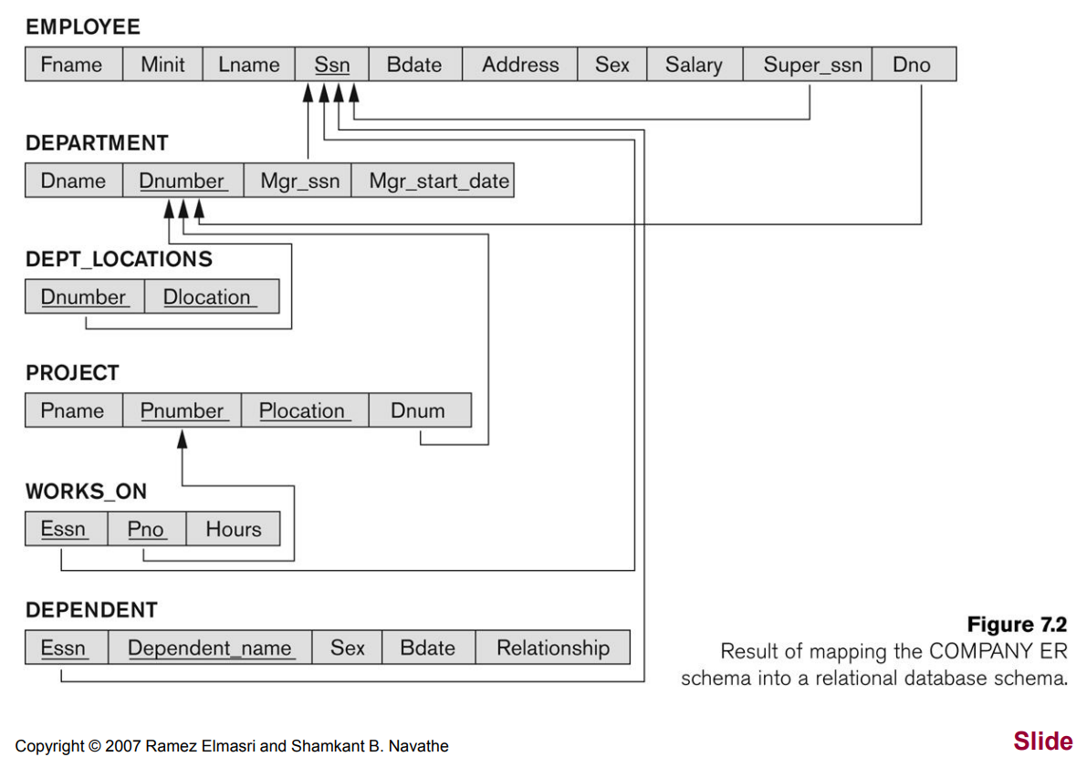
To this

Slide 53
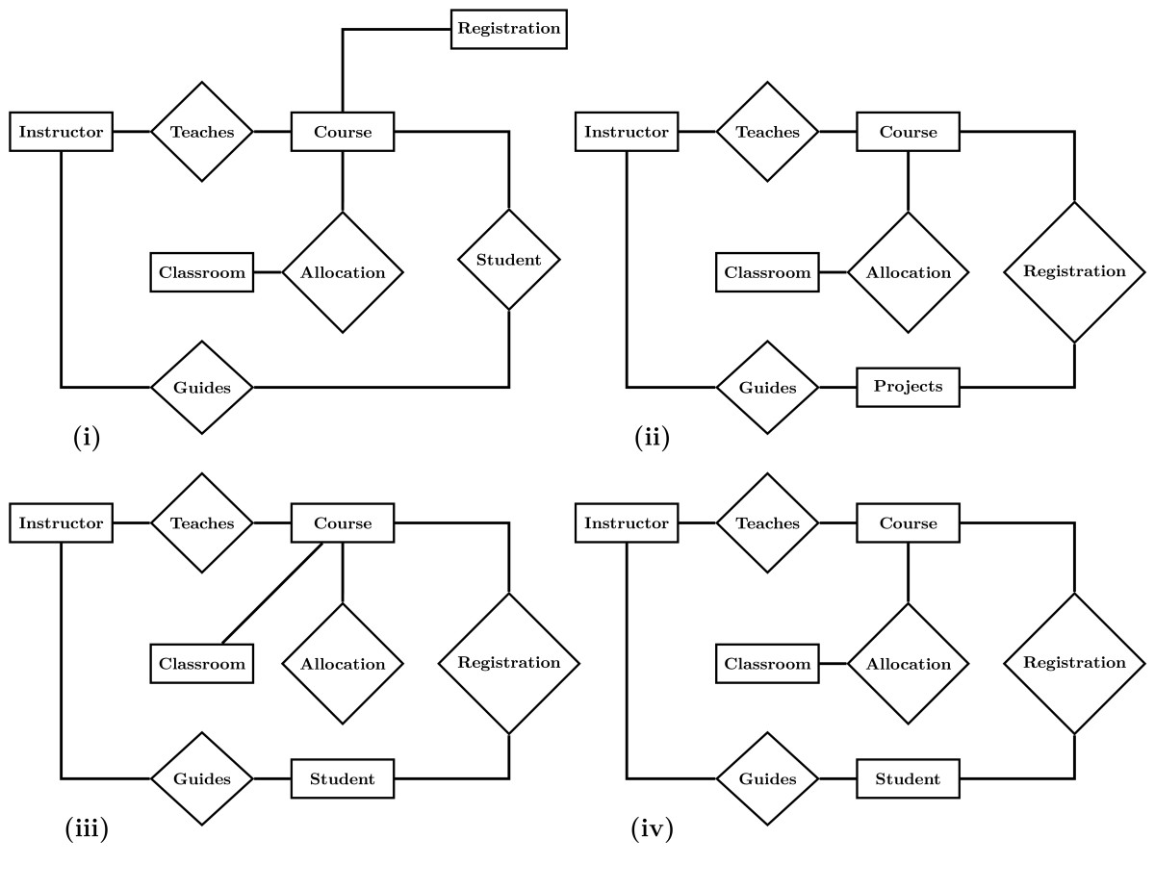
ER Diagram Questions
Answer: iv

Slide 54
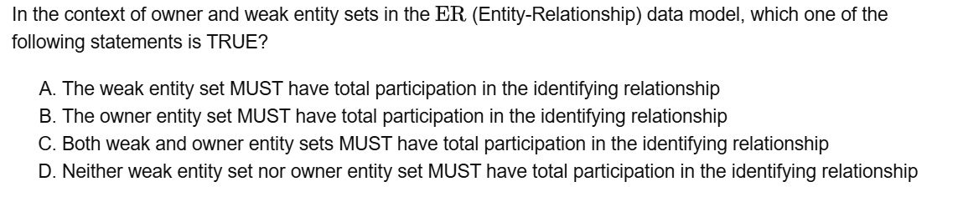
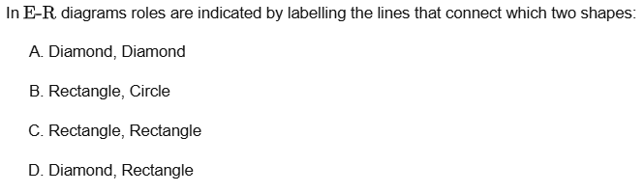
ER Diagram Questions
Answer: A
Answer: D

